Slide 1
Chapter 7
Investment Decision Rules

Slide 2
Chapter Outline
7.1 NPV and Stand-Alone Projects
7.2 The Internal Rate of Return Rule
7.3 The Payback Rule
7.4 Choosing Between Projects
7.5 Project Selection with Resource Constraints

Slide 3
7.1 NPV and Stand-Alone Projects
Consider a take-it-or-leave-it investment decision involving a single, stand-alone project for Fredrick’s Feed and Farm (FFF).
The project costs $250 million and is expected to generate cash flows of $35 million per year, starting at the end of the first year and lasting forever.

Slide 4
Applying the NPV Rule
The NPV of the project is calculated as:
The NPV is dependent on the discount rate.

Slide 5
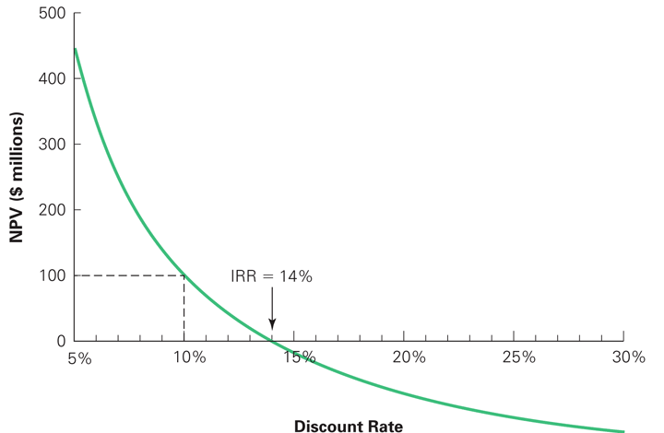
Figure 7.1 NPV of Fredrick’s Fertilizer Project
If FFF’s cost of capital is 10%, the NPV is $100 million, and they should undertake the investment.

Slide 6
Alternative Rules Versus the NPV Rule
Sometimes alternative investment rules may give the same answer as the NPV rule, but at other times they may disagree.
When the rules conflict, the NPV decision rule should be followed.

Slide 7
7.2 The Internal Rate of Return Rule
Internal Rate of Return (IRR) Investment Rule
Take any investment where the IRR exceeds the cost of capital. Turn down any investment whose IRR is less than the cost of capital.

Slide 8
The Internal Rate of Return Rule (cont'd)
The IRR Investment Rule will give the same answer as the NPV rule in many, but not all, situations.
In general, the IRR rule works for a stand-alone project if all of the project’s negative cash flows precede its positive cash flows.
In Figure 7.1, whenever the cost of capital is below the IRR of 14%, the project has a positive NPV, and you should undertake the investment.

Slide 9
Applying The IRR Rule
In other cases, the IRR rule may disagree with the NPV rule and thus be incorrect.
Situations where the IRR rule and NPV rule may be in conflict:
Delayed Investments
Nonexistent IRR
Multiple IRRs

Slide 10
Applying The IRR Rule (cont'd)
Pitfall 1: Delayed Investments
Assume you have just retired as the CEO of a successful company. A major publisher has offered you a book deal. The publisher will pay you $1 million upfront if you agree to write a book about your experiences. You estimate that it will take three years to write the book. The time you spend writing will cause you to give up speaking engagements amounting to $500,000 per year. You estimate your opportunity cost to be 10%.

Slide 11
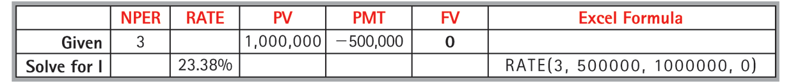
Applying The IRR Rule (cont'd)
Pitfall 1: Delayed Investments
Should you accept the deal?
Calculate the IRR.
The IRR is greater than the cost of capital. Thus, the IRR rule indicates you should accept the deal.

Slide 12
Financial Calculator Solution

Slide 13
Applying The IRR Rule (cont'd)
Pitfall 1: Delayed Investments
Should you accept the deal?
Since the NPV is negative, the NPV rule indicates you should reject the deal.

Slide 14
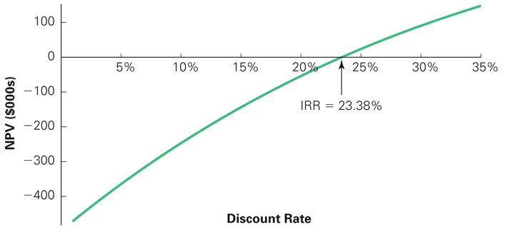
Figure 7.2 NPV of Star’s $1 Million Book Deal
When the benefits of an investment occur before the costs, the NPV is an increasing function of the discount rate.

Slide 15
Applying The IRR Rule (cont'd)
Pitfall 2: Multiple IRRs
Suppose Star informs the publisher that it needs to sweeten the deal before he will accept it. The publisher offers $550,000 advance and $1,000,000 in four years when the book is published.
Should he accept or reject the new offer?

Slide 16
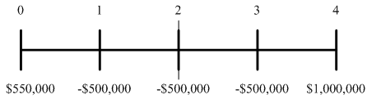
Applying The IRR Rule (cont'd)
Pitfall 2: Multiple IRRs
The cash flows would now look like
The NPV is calculated as

Slide 17
Applying The IRR Rule (cont'd)
Pitfall 2: Multiple IRRs
By setting the NPV equal to zero and solving for r, we find the IRR. In this case, there are two IRRs: 7.164% and 33.673%. Because there is more than one IRR, the IRR rule cannot be applied.

Slide 18
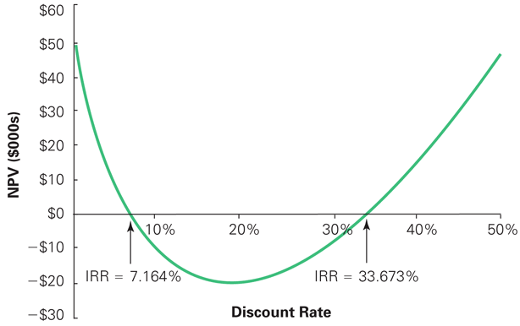
Figure 7.3 NPV of Star’s Book Deal with Royalties

Slide 19
Applying The IRR Rule (cont'd)
Pitfall 2: Multiple IRRs
Between 7.164% and 33.673%, the book deal has a negative NPV. Since your opportunity cost of capital is 10%, you should reject the deal.

Slide 20
Applying The IRR Rule (cont'd)
Pitfall 3: Nonexistent IRR
Finally, Star is able to get the publisher to increase his advance to $750,000, in addition to the $1 million when the book is published in four years. With these cash flows, no IRR exists; there is no discount rate that makes NPV equal to zero.

Slide 21
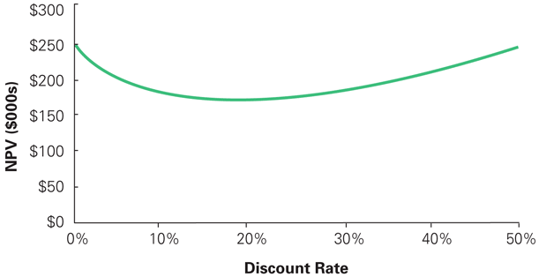
Figure 7.4 NPV of Star’s Final Offer
No IRR exists because the NPV is positive for all values of the discount rate. Thus the IRR rule cannot be used.

Slide 22
Applying The IRR Rule (cont'd)
IRR Versus the IRR Rule
While the IRR rule has shortcomings for making investment decisions, the IRR itself remains useful. IRR measures the average return of the investment and the sensitivity of the NPV to any estimation error in the cost of capital.

Slide 23
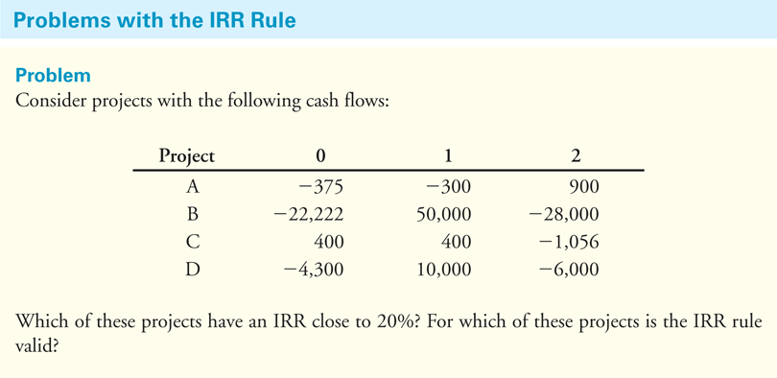
Textbook Example 7.1

Slide 24
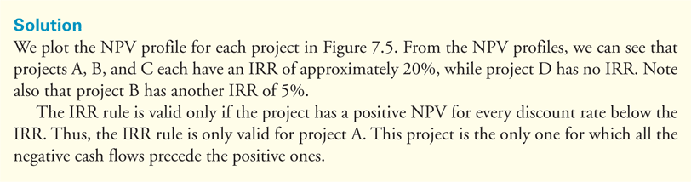
Textbook Example 7.1 (cont’d)

Slide 25
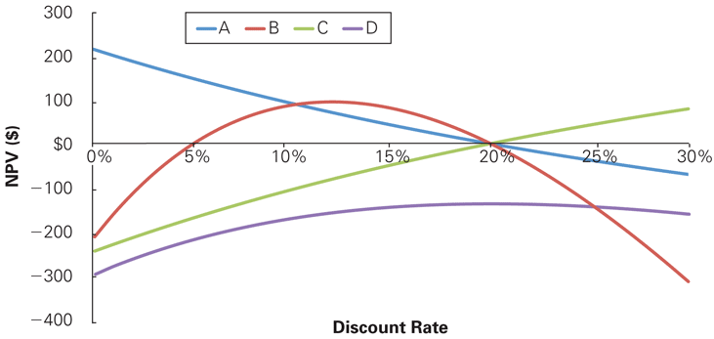
NPV Profiles for Example 7.1
While the IRR Rule works for project A, it fails for
each of the other projects.

Slide 26
7.3 The Payback Rule
The payback period is amount of time it takes to recover or pay back the initial investment. If the payback period is less than a pre-specified length of time, you accept the project. Otherwise, you reject the project.
The payback rule is used by many companies because of its simplicity.

Slide 27
The Payback Rule (cont’d)
Pitfalls
Ignores the project’s cost of capital and time value of money.
Ignores cash flows after the payback period.
Relies on an ad hoc decision criterion.

Slide 28
7.4 Choosing Between Projects
Mutually Exclusive Projects
When you must choose only one project among several possible projects, the choice is mutually exclusive.
NPV Rule
Select the project with the highest NPV.
IRR Rule
Selecting the project with the highest IRR may lead to mistakes.

Slide 29
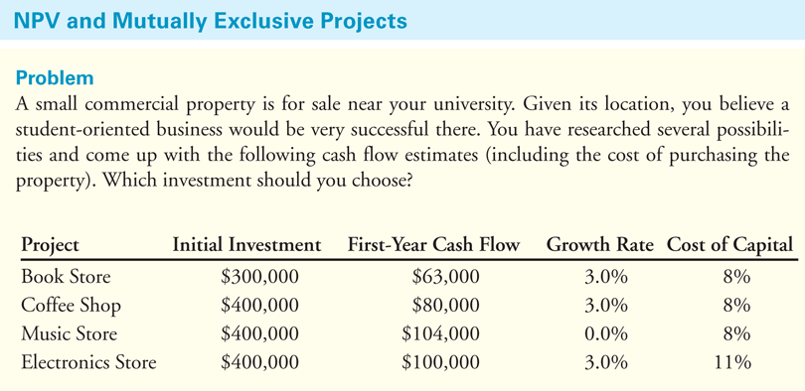
Textbook Example 7.3

Slide 30
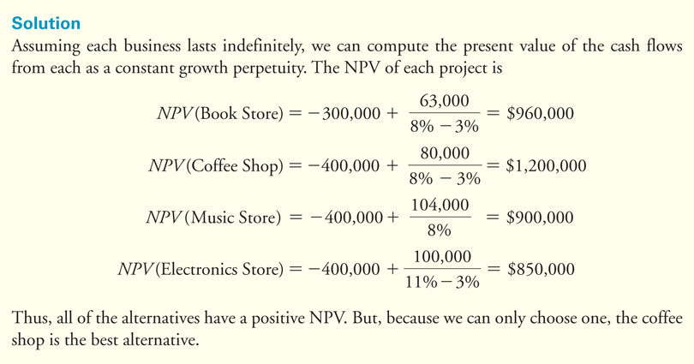
Textbook Example 7.3 (cont’d)

Slide 31
IRR Rule and Mutually Exclusive Investments: Differences in Scale
If a project’s size is doubled, its NPV will double. This is not the case with IRR. Thus, the IRR rule cannot be used to compare projects of different scales.

Slide 32
IRR Rule and Mutually Exclusive Investments: Timing of Cash Flows
Another problem with the IRR is that it can be affected by changing the timing of the cash flows, even when the scale is the same.
IRR is a return, but the dollar value of earning a given return depends on how long the return is earned.
Consider again the coffee shop and the music store investment in Example 7.3. Both have the same initial scale and the same horizon. The coffee shop has a lower IRR, but a higher NPV because of its higher growth rate.

Slide 33
IRR Rule and Mutually Exclusive Investments: Differences in Risk
An IRR that is attractive for a safe project need not be attractive for a riskier project.
Consider the investment in the electronics store from Example 7.3. The IRR is higher than those of the other investment opportunities, yet the NPV is the lowest.
The higher cost of capital means a higher IRR is necessary to make the project attractive.

Slide 34
The Incremental IRR Rule
Incremental IRR Investment Rule
Apply the IRR rule to the difference between the cash flows of the two mutually exclusive alternatives (the increment to the cash flows of one investment over the other).

Slide 35
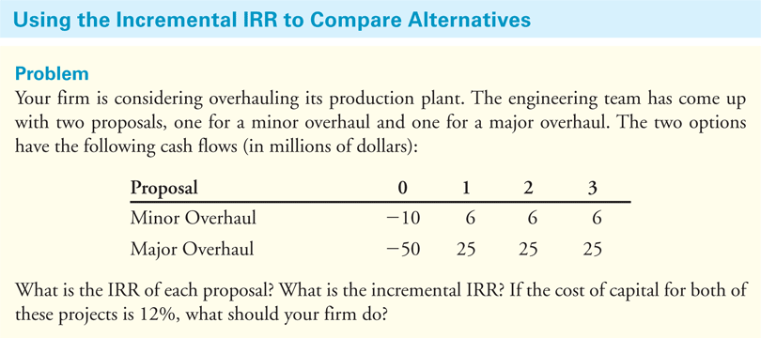
Textbook Example 7.4

Slide 36
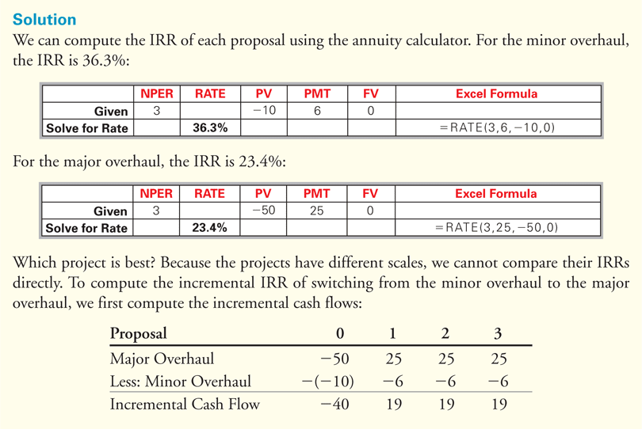
Textbook Example 7.4 (cont’d)

Slide 37
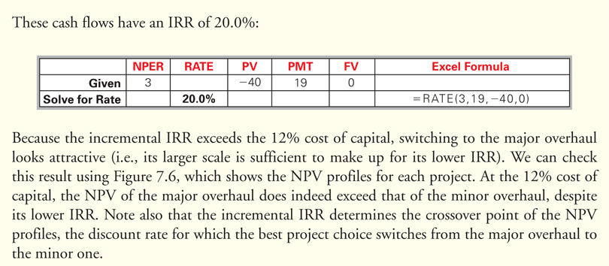
Textbook Example 7.4 (cont’d)

Slide 38
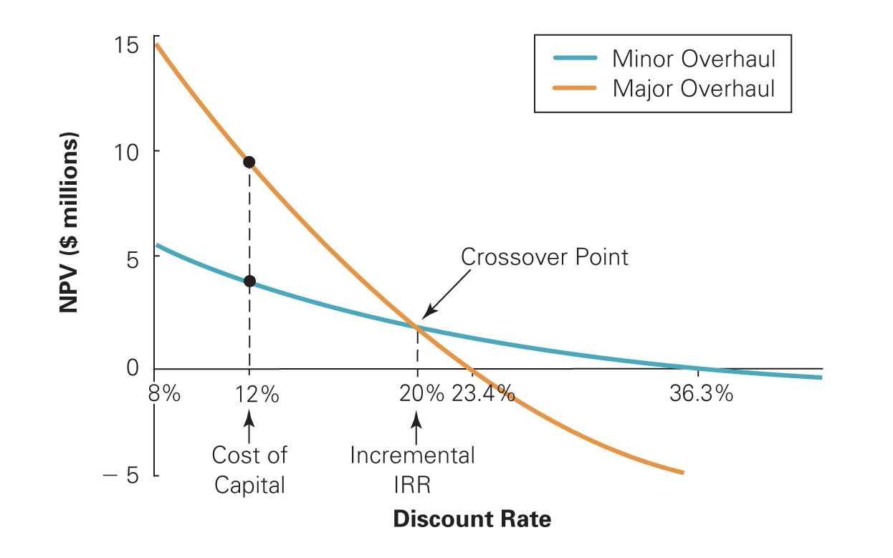
Figure 7.5 Comparison of Minor and Major Overhauls
In Example7.4, we can see that despite its lower IRR, the major overhaul has a higher NPV at the cost of capital of 12%. Note also that the incremental IRR of 20% determines the crossover point or discount rate at which the optimal decision changes.

Slide 39
The Incremental IRR Rule (cont'd)
Shortcomings of the Incremental IRR Rule
The incremental IRR may not exist.
Multiple incremental IRRs could exist.
The fact that the IRR exceeds the cost of capital for both projects does not imply that either project has a positive NPV.
When individual projects have different costs of capital, it is not obvious which cost of capital the incremental IRR should be compared to.

Slide 40
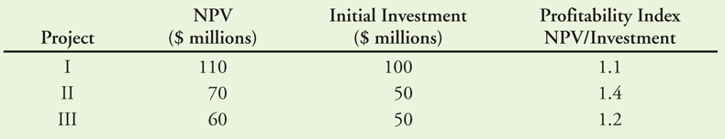
7.5 Project Selection with Resource Constraints
Evaluation of Projects with Different Resource Constraints
Consider three possible projects with a $100 million budget constraint:
Table 7.1 Possible Projects for a $100 Million Budget

Slide 41
Profitability Index
The profitability index can be used to identify the optimal combination of projects to undertake.
From Table 7.1, we can see it is better to take projects II & III together and forgo project I.

Slide 42
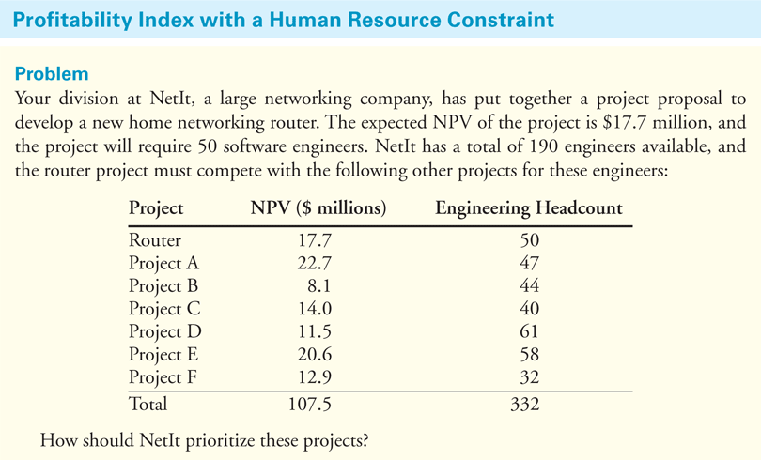
Textbook Example 7.5

Slide 43
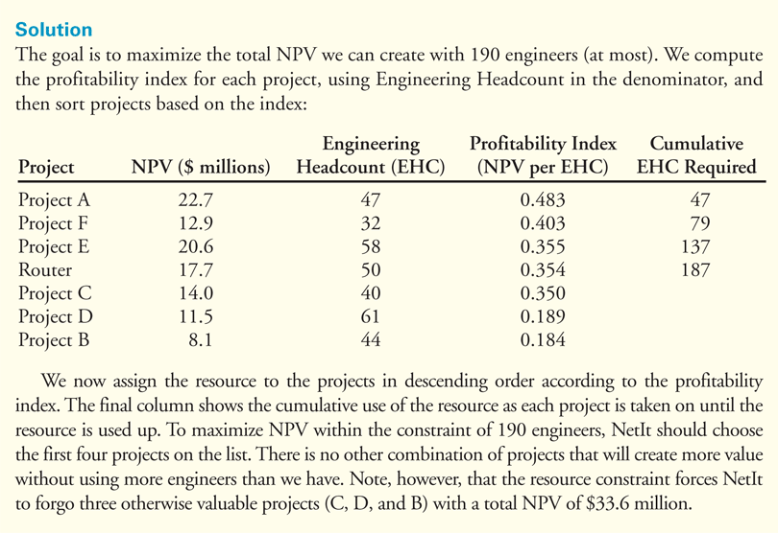
Textbook Example 7.5 (cont’d)

Slide 44
Shortcomings of the Profitability Index
In some situations the profitability Index does not give an accurate answer.
Suppose in Example 7.4 that NetIt has an additional small project with a NPV of only $120,000 that requires three engineers. The profitability index in this case is 0.1 2/ 3 = 0.04, so this project would appear at the bottom of the ranking. However, three of the 190 employees are not being used after the first four projects are selected. As a result, it would make sense to take on this project even though it would be ranked last.

Slide 45
Shortcomings of the Profitability Index (cont'd)
With multiple resource constraints, the profitability index can break down completely.

